Slide 1
Introduction to Quantum Computing: From a Layperson to a Programmer in 30 Steps
Hiu-Yung Wong
https://link.springer.com/book/10.1007/978-3-030-98339-0
https://www.amazon.com/Introduction-Quantum-Computing-Layperson-Programmer/dp/3030983382
Playlist: https://www.youtube.com/watch?v=U00tUKf5T7g&list=PLnK6MrIqGXsJfcBdppW3CKJ858zR8P4eP&index=5 eP
https://www.youtube.com/watch?v=U00tUKf5T7g&list=PLnK6MrIqGXsJfcBdppW3CKJ858zR8P4eP&index=5
https://www.youtube.com/watch?v=b4OX67AE574&list=PLnK6MrIqGXsJfcBdppW3CKJ858zR8P4eP&index=6

Slide 2

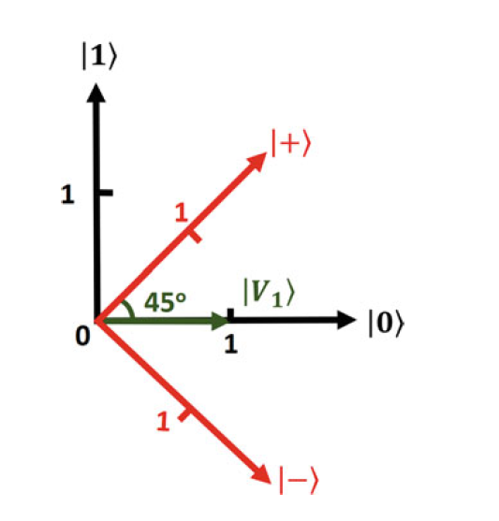



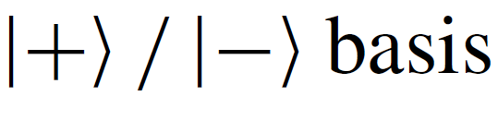
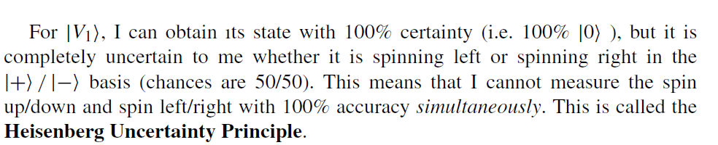
Changing Basis and Heisenberg Uncertainty Principle (Simplified view)
This representation does not correspond to spin system. It is just a nice illustration.

Slide 3
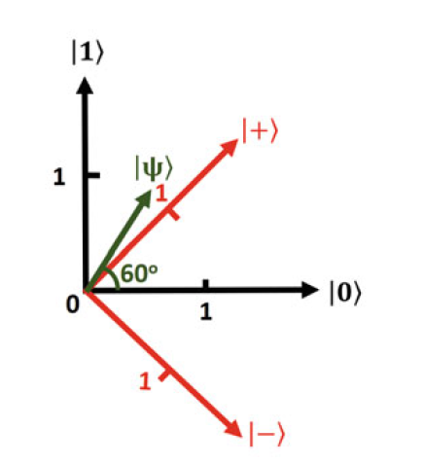
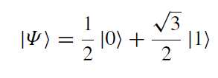

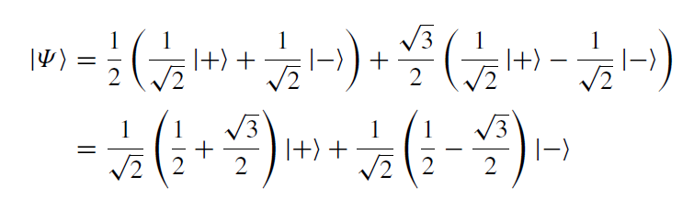
Changing Basis (another example)
This representation does not correspond to spin system. It is just a nice illustration.

Slide 4




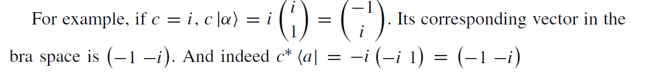

Operation on Bra-Ket
Bra space is dual to Ket space

Slide 5
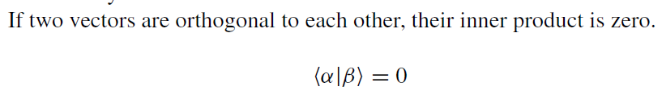
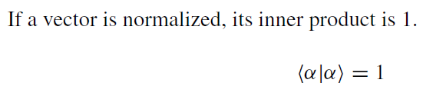


Orthogonality and Normalization

Slide 6
Operator, Eigenvector, Eigenvalues
For a state, we represent it using a vector |a>.
For any operation (e.g. rotation of the vector), we represent it as an operator A.
If we apply A to |a>, for certain |a’>, |a’’>… it becomes a constant times those vectors (a’|a’>, a’’|a’’>…)
Then a’, a’’ are called the eigenvalues of A and |a’>, |a’’> are called the eigenvectors of A.
N×N matrix only has N eigenvectors

Slide 7
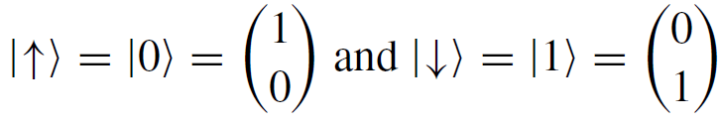
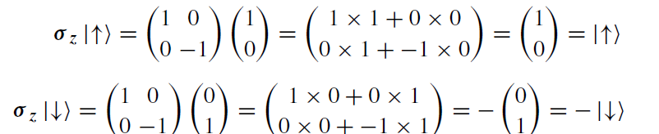
Operator and Eigenvalue Example – Pauli Spin Matrices

